Slide 1
The American Express Campus Challenge 2024
Pranjay Sidhwani
Agniv Nath Atharva Paranjape
IIT Delhi
ChadGPT
Notes:
1

Slide 2
Summary of the Final Solution
Objective Function/Dependent Variable
Sampling
Feature Engineering
Modeling Technique
Any other Dimension?
We have used the following feature engineering steps:-
Mapping categorical features to numerical values, such as 'lighting' and 'toss winner'.
Creation of new features based on conditions, such as batting_first, toss_winner_tag, and team1_action.
Normalisation of win_amount series by using own factor scaling.
Defined functions to aggregate historical performance metrics for teams and players.
Ratio calculations for various performance metrics with Calculation of various averages and performance ratios based on past match data.
The modeling technique used here is a machine-learning approach involving the LightGBM algorithm, which is a gradient boosting framework that uses tree-based learning algorithms.
It is used for its speed, scalability, and high accuracy, along with advanced features like handling categorical data directly.
Data Preprocessing: The data is preprocessed to extract relevant features.
Feature Engineering: New features are created based on historical match data
StratifiedKFold Cross-Validation: It ensures that each fold of the cross-validation contains approximately the same percentage of samples of each target class as the original dataset.
LightGBM model and performance metrics for evaluating models performance and implemented HMM for predicting winning probabilities
Instead of predicting whether the Batting first team wins or loses we could predict the runs scored by each team in the match.
Instead of using ratios, predicting the actual runs scored by each team in a match could provide more granular and accurate information for predicting the winner. This approach eliminates the potential loss of information inherent in ratios and directly predicts outcomes based on comprehensive match statistics.
By forecasting runs, the model can offer deeper insights into team performance and improve the accuracy of win predictions in cricket matches.
Objective Function:-
Binary classification with the goal to predict whether the team batting first will win or lose.
The dependent variable used is the Winner_tag, which indicates whether the team batting first will win or lose.
We have used stratified sampling technique.
Stratified sampling, when used with k-fold cross-validation (CV) in the context of LightGBM ensures that each fold of the dataset has the same proportion of samples from each class as the original dataset. This is particularly useful when dealing with imbalanced datasets, as it ensures that each fold is representative of the overall class distribution.

Slide 3
Model Performance – All Iterations
Only with the given features the model results with a accuracy of 50%,
With feature engineering, the model's accuracy jumps to 69.7% , and with stratified sampling it goes upto 72.6%.
We can see a significant jump in accuracy after applying feature engineering.
Accuracy
[Out of Sample/Validation Results]
72.60%​
50%​5
69.7%
*Output from the evaluation code provided to participants, on the out of sample/validation data that they created from the training data

Slide 4
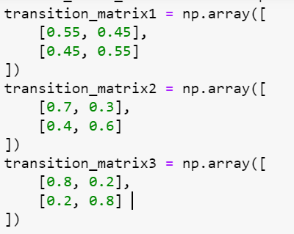
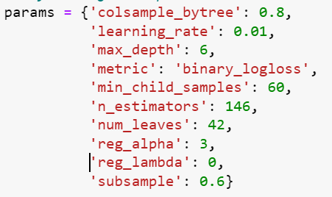
Model Technique/Algorithm Details
Predicting Probability using Hidden Markov Chain:
States: Win and Loss.
Transition Matrices:
Emission Matrix: Defines the probability of observing a particular outcome given the
current state.
Viterbi Algorithm: Used for finding the most probable sequence of states given the
observed sequence.
Initialization: The algorithm starts by initializing the Viterbi matrix with probabilities
based on the initial state distribution and emission matrix.
Recursion: Updates the Viterbi matrix and backpointer matrix based on the selected transition matrix and emission probabilities.
Termination: Backtracks through the backpointer matrix to determine the most probable sequence of states.
LightGBM (Light Gradient Boosting Machine):
Framework: LightGBM is an efficient and high-performance gradient boosting framework that uses tree-based learning algorithms. It is designed for speed and performance optimization.
Parameters:
Boosting Algorithm and Ensemble models (k=5)
Cross-Validation: Stratified K-Fold cross-validation is used to ensure that each fold of
the dataset has the same proportion of observations with a given label.
n_splits: Number of splits for cross-validation (5 in this case).
shuffle: Shuffle the data before splitting into folds.
random_state: Seed used by the random number generator.
Hyper-tuned Parameters using CV grid

Slide 5
Real World Examples: Optiver Trading at the Close: To predict prices of 200 Nasdaq stocks for the “Trading at the Close”. Piramal Finance Hackathon: Predicted Rate of Interest for the loan based on the past credit history of the person. Finance: Predicted the Risk factor of UPI transactions based on historical data’s such as Transaction amount ,VPA , IP address etc. Academic Literatures: Original Paper by Microsoft: "LightGBM: A Highly Efficient Gradient Boosting Decision Tree" - This paper introduces LightGBM and demonstrates its advantages over other gradient boosting implementations. Markov Chain Model for American Football: https://sciendo.com/pdf/10.1515/ijcss-2017-0014 -
Training and Evaluation:
The model is trained on the training set (X_train, y_train) and evaluated on the test set (Xtest, Ytest) in each fold.
Early stopping is employed to prevent overfitting by stopping training if the validation score does not improve after a specified number of rounds (stopping_rounds).
Performance Metrics: accuracy_score: Accuracy, F1 score, precision, recall, ROC AUC, and Pearson correlation are calculated.
Feature Importance:
Feature importances are accumulated across all folds and averaged.
Two methods are used for feature importance visualization:
LightGBM Feature Importance: Importance derived from the model directly.
SHAP (SHapley Additive exPlanations): Explains the output of the model by computing the contribution of each feature to each prediction.
Blending HMM and LightGBM: Combines predictions from LightGBM and HMM by averaging their probabilities to make the final classification.

Slide 6
Feature Engineering & Selection
The following features were created/engineered …
S. No. | Feature | Feature Description
1 | past_runs | Ratio of Runs scored by the teams previously
2 | past_wickets | Ratio of Wickets taken by the teams previously
3 | past_wins | Ratio of No. of Matches won previously
4 | past_win_amount | Ratio of average win by amount
5 | POF | Ratio of number of player of matches
6 | ground_wins | Percentage of batting first team won on the ground
7 | hund_ratio | Ratio of sum of number of 100 by players playing.
8 | bt_avg | Ratio of Batting average runs of a players playing
9 | bt_str | Ratio of avg. Strike rate of the batsman playing
10 | maiden | Ratio of number of maiden overs by players playing
11 | extras | Ratio of extra runs given by bowler playing
12 | dots | Ratio of no. Of dot balls thrown by bowler playing
13 | three_wickets | Ratio of No of three wicket hauls for a bowler playing
14. | bow_wic | Ratio of sum of wickets taken by bolwer playing
S. No. | Feature | Feature Description
15 | bow_eco | Ratio of average economy of bowlers previously
16 | bow_avg | Ratio of average balls per wicket of bowlers previously
17 | four | Ratio of sum of fours of batsman playing
18 | six | Ratio of sum of fours of batsman playing
19 | team1_batting_first_percentage | Percentage of team 1 when batting first won in the past
20 | team2_bowling_first_percentage | Percentage of team 1 when bowling first won in the past
21 | par_score | ground_avg_runs_last15 -team1only_avg_runs_last15
22 | POF_bt_st | POF*bt_st
23 | 'bt1_avg_POF_1 | POF1*bt1_avg
24 | past_wins_1_bt1_str | Past_wins_1*bt1_str
Mention about any feature selection that was used
Feature selection was done using the SHAP values to learn how much a feature is important and how much it affects the outcome.

Slide 7
Top 10 Features in the Final Solution
Rank | Feature | Importance by LGBM
(1) | team_count_50runs_last15 | 3.6
(2) | past_win_amount | 3.0
(3) | bow_eco | 3.0
(4) | bt_str | 3.0
(5) | past_wins_1_bt1_str | 2.8
(6) | bt1_avg_POF_1 | 2.6
(7) | past_runs | 2.4
(8) | maiden | 2.2
(9) | extras | 2.0
(10) | POF | 2.0
Rank | Feature | Importance by SHAP
(1) | team_count_50runs_last15 | 0.125058
(2) | extras | 0.121446
(3) | bt1_avg_POF_1 | 0.079480
(4) | POF_bt_str | 0.074687
(5) | ground_wins | 0.063138
(6) | past_wins | 0.057408
(7) | bow_eco | 0.049659
(8) | past_win_amount | 0.043671
(9) | POF | 0.042691
(10) | Three_wickets | 0.042634

Slide 8
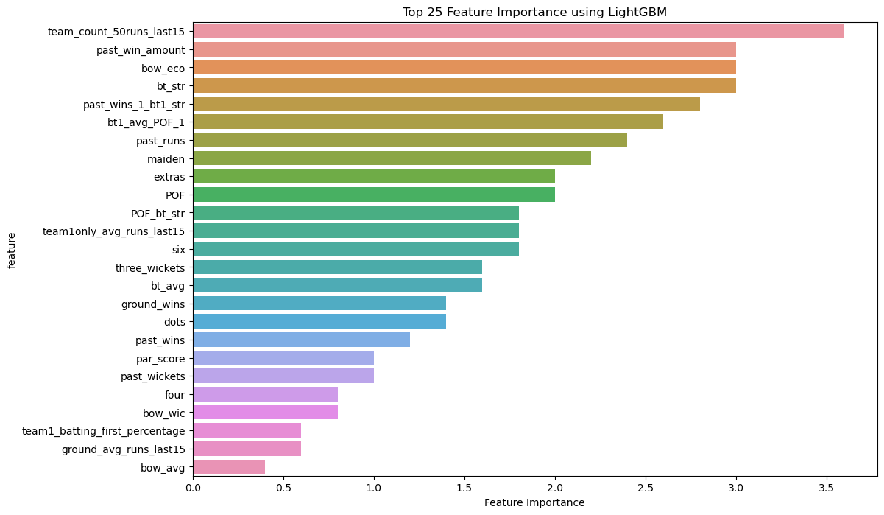
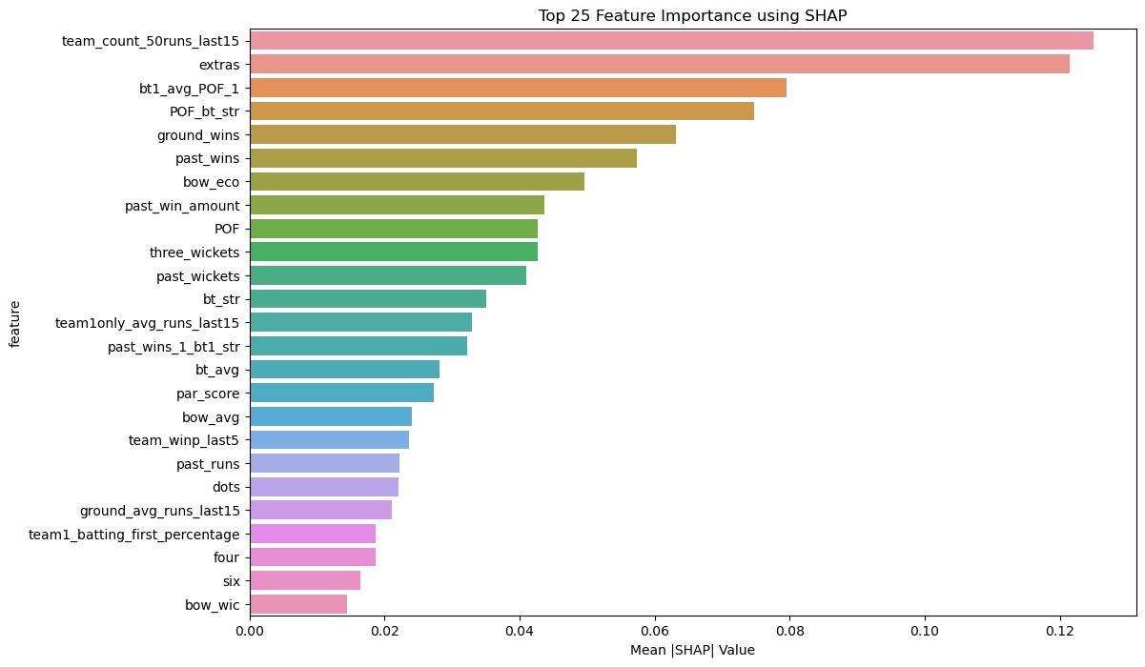
Top 25 Features Graph in the Final Solution
Importance by LGBM
Importance by SHAP​

Slide 9
Sampling Technique Used
Detailed overview of the Sampling Technique
Mention about why this sampling technique was used
Stratified sampling is used for training in classification machine learning problems to ensure that each class is adequately represented in both the training and test datasets. This is particularly important for imbalanced datasets, where some classes are much less frequent than others. By maintaining the class distribution, stratified sampling improves model performance by helping the model learn the underlying patterns of each class more effectively. It also reduces variance in performance estimates and ensures a fair evaluation of the model, leading to more robust and reliable results.
Share some numbers on change in count of rows, event rate etc..
The dataset which was given to us was equally balanced, i.e. there was no need to perform any task related to the balancing of the dataset. Hence there was no change in count of rows.

Slide 10
More Potential to Improve (Optional)
Additional things that participants feel could have increased the performance of the model further..
Granular Information and Improved Accuracy: Predicting actual runs captures detailed information, leading to better understanding and accuracy.
Leveraging Comprehensive Match Statistics: Utilizes richer match statistics, enhancing the model's ability to forecast outcomes with deeper insights.
Enhanced Feature Engineering: Enables advanced feature engineering, capturing complex interactions and temporal dependencies for more robust predictions.
1
ML Enhancements
Incorporating Context-Specific Features: Utilize features like powerplay overs, death overs, and partnerships to capture critical match phases.
Capturing Temporal Dependencies: Implement time-based features to reflect match progression and momentum shifts, improving prediction accuracy.
2
Feature Engineering
3
Handling Missing Values: Implement strategies like imputation or model-based methods to address missing data, ensuring robustness.
Data Normalization and Scaling: Normalize and scale features to improve model convergence and performance, especially for algorithms sensitive to feature magnitudes. More better scaling factor could be chosen for converting win amount.
Any other dimension?

